Slide 1

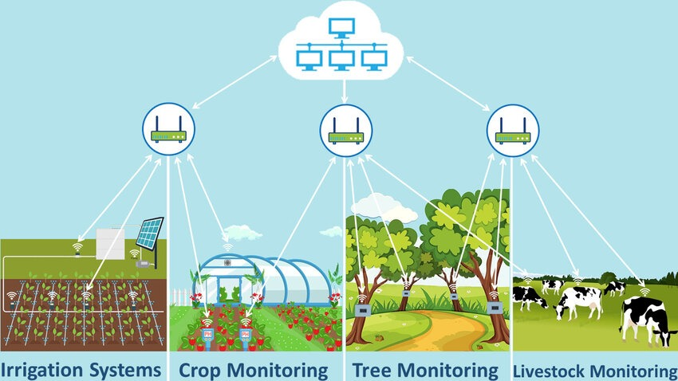
LoRa-Based Wireless Monitoring System For Environmental Irregularity detection
Submitted by : Sayantan Mandal [22BCE8533]

Slide 2
Contents:
Title Slide
Introduction
Problem Statement
Objective
System Overview
Hardware Components
Working Principle
Software Overview
Network Architecture
Applications
Advantages
Limitations and Challenges
Results
Future Scope
Conclusion
References

Slide 3
Introduction
Environmental irregularity detection using LoRa (Long Range) technology enables reliable monitoring of environmental conditions over large distances with minimal power consumption. LoRa's long-range wireless communication capability makes it ideal for remote or hard-to-reach areas where traditional networks may not be feasible. By using LoRa, sensor data such as temperature, humidity, or gas levels can be transmitted efficiently to a central node or gateway for analysis. This makes it especially useful in applications like forest fire detection, air quality monitoring, and agricultural field management, where real-time data from widely distributed sensors is essential for early detection and timely response.

Slide 4
Problem Statement
Traditional environmental monitoring systems face major limitations such as short communication range, high power consumption, limited scalability, and inability to detect anomalies in real time. These challenges hinder effective remote monitoring in applications like precision agriculture and environmental sustainability efforts. There is a pressing need for a cost-effective, long-range, low-power, and intelligent monitoring system that can detect environmental irregularities automatically and operate efficiently in remote areas

Slide 5
Objectives
Develop a low-power, long-range LoRa-based environmental monitoring system.
Integrate sensors (temperature, humidity, soil moisture) with Arduino Uno and ESP32.
Enable real-time remote data collection and monitoring.
Apply machine learning to detect environmental anomalies.
Ensure energy efficiency for long-term, remote deployment.
Support scalability for large-area monitoring using multiple LoRa nodes.

Slide 6
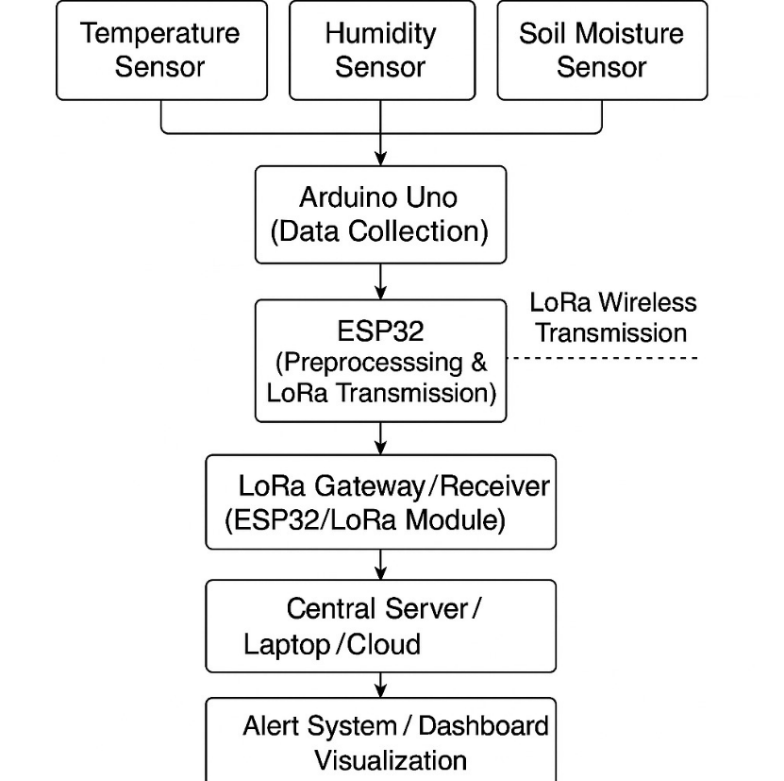
System Overview
The system is a LoRa-based Wireless Environmental Monitoring Solution that uses long-range, low-power communication to monitor temperature, humidity, and soil moisture in real time. Data collected by sensors is processed through an Arduino Uno and ESP32, transmitted via LoRa, and analyzed using a machine learning model for anomaly detection. Alerts and data visualization are provided through a central dashboard.

Slide 7
Hardware Components
Sensors:
Temperature Sensor: Measures the ambient temperature of the environment.
Humidity Sensor: Monitors the atmospheric moisture levels.
Soil Moisture Sensor: Detects the water content in the soil to assess soil health.
Microcontrollers:
Arduino Uno: Collects and aggregates sensor data from different environmental sensors.
ESP32: Handles data preprocessing and manages LoRa communication for transmitting sensor data to the receiver.
Communication Module:
LoRa Module (SX1278 or equivalent): Enables long-range, low-power wireless communication between sensor nodes and the central server/gateway.
Central Gateway:
An ESP32 device or a dedicated LoRa receiver connected to a server or laptop for data collection.

Slide 8
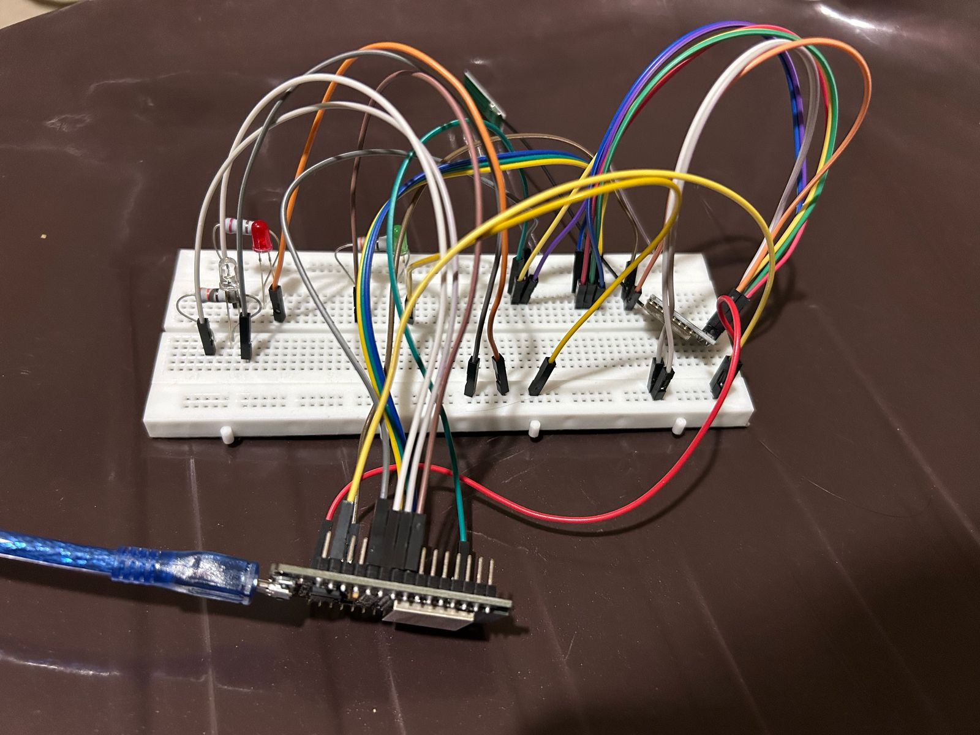
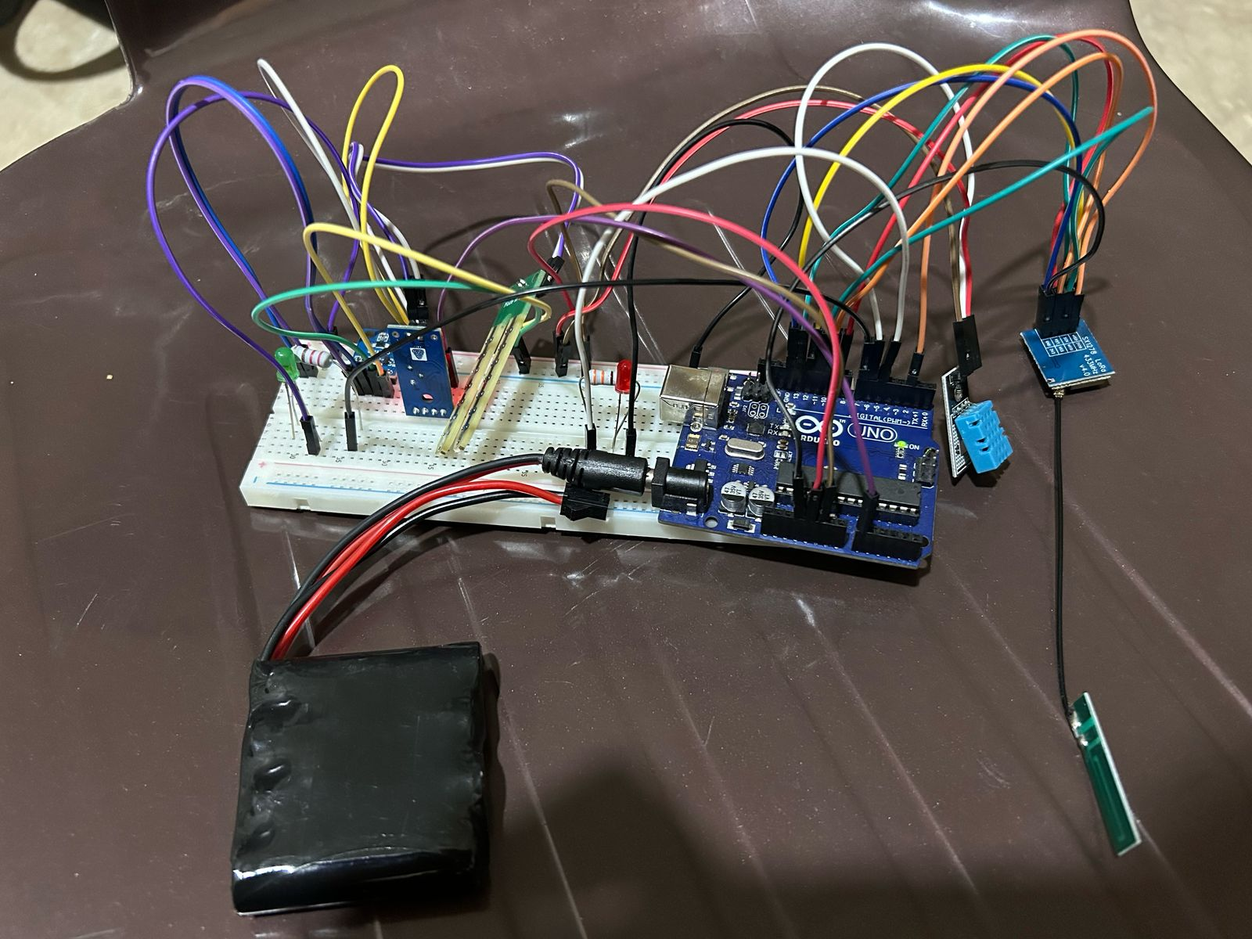

Slide 9
Working Principle
The system operates by collecting environmental data, transmitting it wirelessly using LoRa, and analyzing it for anomalies to trigger alerts.
Data Collection: Sensors (temperature, humidity, soil moisture) continuously measure environmental conditions.
Arduino Uno reads and aggregates sensor data at regular intervals.
Data Transmission: The collected data is sent from the Arduino to the ESP32.
The ESP32 preprocesses the data (formatting, error checking) and transmits it wirelessly using the LoRa module.
LoRa communication ensures long-range, low-power data transfer to a central receiver/gateway.
Monitoring and Alerts: The central server (with a LoRa receiver) collects incoming data.
A machine learning model processes the data to detect anomalies (e.g., unusual soil moisture or temperature spikes).
If an anomaly is detected, the system generates an instant alert and displays the information on a real-time dashboard.

Slide 10
Software Overview
The system is programmed using Arduino IDE. The Arduino Uno collects sensor data, while the ESP32 handles LoRa transmission.
Libraries Used:
LoRa.h: For LoRa communication.
DHT.h: For temperature and humidity sensors.
Wire.h, SoftwareSerial.h: For optional sensor and serial communication.
Communication ProtocolSerial (UART): Arduino ➔ ESP32 (data handoff).
LoRa Wireless: ESP32 ➔ Gateway (data transmission).
Data is sent as simple text (e.g., "Temp:25,Humidity:50,Soil:300").

Slide 11
Network Architecture
The system follows a star topology, where multiple sensor nodes communicate directly with a central LoRa gateway.
Nodes: Arduino Uno + ESP32 modules with sensors (temperature, humidity, soil moisture).
Gateway: ESP32-based receiver or any LoRaWAN gateway.
Communication Range: Tested up to 2 km in open environments, maintaining stable transmission.
This setup ensures simple and efficient communication, ideal for agricultural and environmental monitoring.

Slide 12
Applications
Precision Agriculture: Monitoring soil conditions to optimize irrigation and crop yield.
Remote Environmental Monitoring: Forests, wildlife reserves, or remote weather stations.
Smart Cities: Green belt management and microclimate tracking in urban areas.
Disaster Management: Early detection of drought or flood conditions based on soil and humidity data.

Slide 13
Advantages
Long Range Communication: Covers large distances compared to Wi-Fi or Bluetooth.
Low Power Operation: Suitable for battery-powered and solar-powered deployments.
Cost-Effective: Utilizes affordable microcontrollers and sensors.
Scalability: Easy to expand by adding more sensor nodes to the network without major changes.
Real-Time Monitoring: Immediate data access for proactive decisions.

Slide 14
Limitations and Challenges
Low Data Rate: LoRa supports small packets; not ideal for heavy data like images or video.
Interference Possibility: Performance may degrade in areas with high RF congestion.
Battery Life Management: Nodes require optimized sleep cycles and efficient energy usage for long-term operation.
Line-of-Sight Dependency: Range is optimal in open fields; urban or dense areas might reduce effective range.

Slide 15
Results
Range Testing: Consistent data transmission was achieved over 2 km in open fields, with minor packet losses (~3%).
Sensor Performance:
Temperature readings were stable within ±0.5°C error.
Humidity readings showed ~5% variation across conditions.
Soil moisture data helped distinguish dry and wet soil conditions clearly.
Sample Data:
Temp: 26.4°C, Humidity: 47%, Soil Moisture: 305Temp: 27.1°C, Humidity: 45%, Soil Moisture:280

Slide 16
Future Scope
Sensor Expansion: Integrate pH, CO₂, flood, and seismic sensors for broader analysis.
Advanced Machine Learning: Real-time anomaly detection with self-learning capabilities.
IoT Platform Integration: Connect nodes to cloud dashboards like ThingsBoard, AWS IoT, or Blynk for remote visualization and control.
Energy Harvesting: Solar-powered sensor nodes for indefinite outdoor operation.
Multi-Gateway Mesh Networks: To extend range and reliability in larger fields.

Slide 17
Conclusion
This project successfully demonstrates a robust, scalable, and low-power wireless monitoring solution leveraging LoRa communication and machine learning-based anomaly detection.It offers a cost-effective and practical approach for applications like smart agriculture and environmental conservation.With future integrations and enhancements, the system can play a key role in building smarter, greener, and more sustainable ecosystems.

Slide 18
References
LoRa Technology Overview – Research on LoRa and its applications in IoT.
ESP32 with LoRa using Arduino IDE – A comprehensive guide on interfacing the ESP32 with LoRa transceivers using the Arduino IDE.
Soil Moisture Monitoring in Smart Agriculture – Research on soil moisture sensors and their applications in precision agriculture.
Machine Learning in Environmental Monitoring – Study on applying ML models for anomaly detection.
Energy Efficiency in LoRa-Based Systems – Analysis of power optimization techniques in LoRa IoT devices.

Slide 19
Thank You

